Slide 1
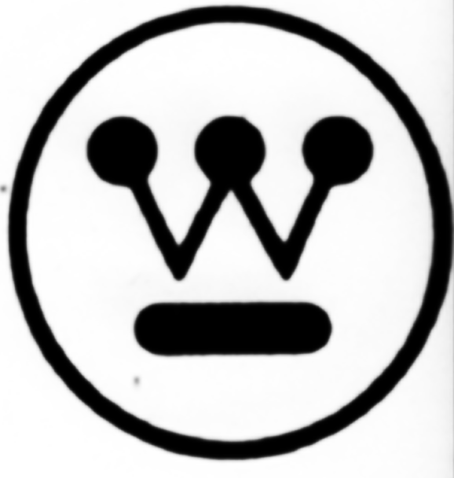
Week 4 – Professional Design
ARTS 1301.05 James Cost

Slide 2
Professional Design During the 1920s in the United States, many people who had once described themselves as involved in the graphic arts, the industrial arts, the craft arts, or the arts allied to architecture, and even architects themselves, began to be referred to as designers. They were seen as serving industry. They could take any object or product—a shoe, a chair, a book, a poster, an automobile, or a building—and make it appealing, and thereby persuade the public to buy it or a client to build it.

Slide 3
Professional Design People find products appealing for two reasons—their functionality and their style. Obviously, a product needs to work, and work well, to attract buyers. But it also has to look good, and this “look,” or style, is a stimulus for consumption and show. It implies not only aesthetic appeal but good taste. Most successful product design embodies both functionality and a distinctive stylistic appearance.

Slide 4
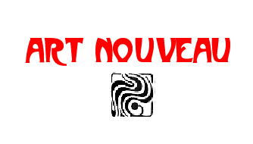
ARTC 2316 History of Communication Graphics

Slide 8
European Art Nouveau Artists

Slide 9
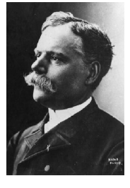
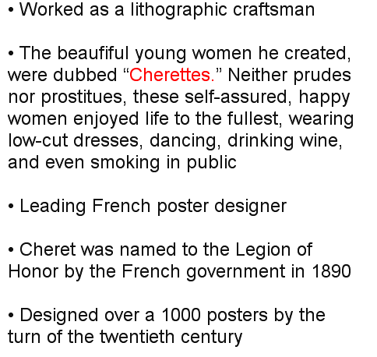
Jules Cheret 1836-1933

Slide 10
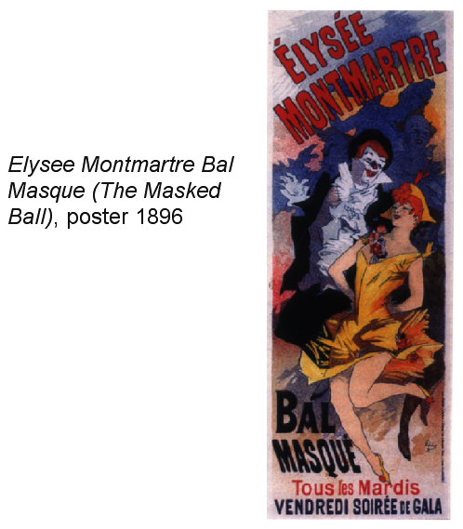
Jules Cheret

Slide 11
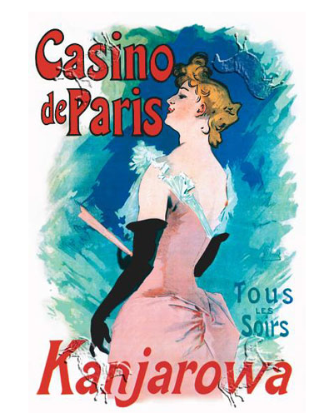
Jules Cheret

Slide 12
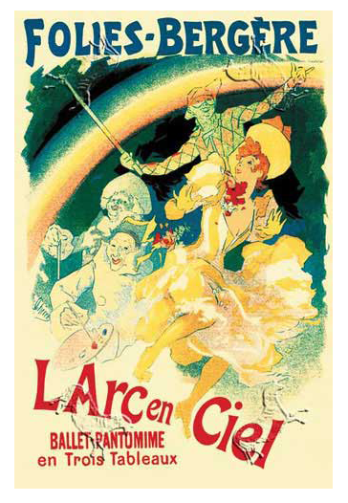
Jules Cheret

Slide 13
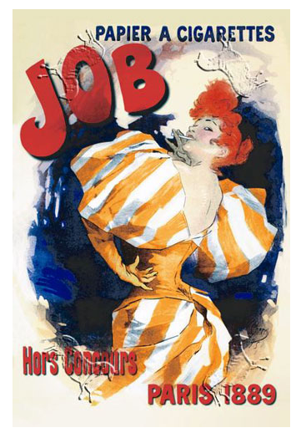
Jules Cheret

Slide 14
Eugene Grasset 1841-1917

Slide 15
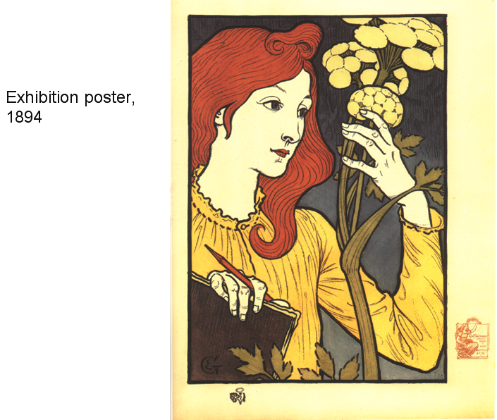
Eugene Grasset

Slide 16
Eugene Grasset

Slide 17
Eugene Grasset

Slide 18
Eugene Grasset

Slide 19
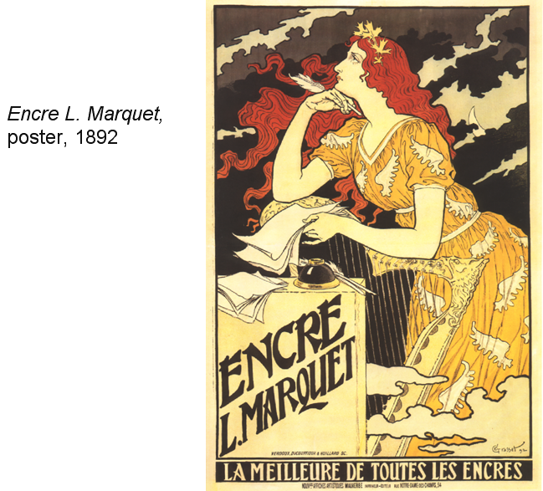
Eugene Grasset

Slide 20
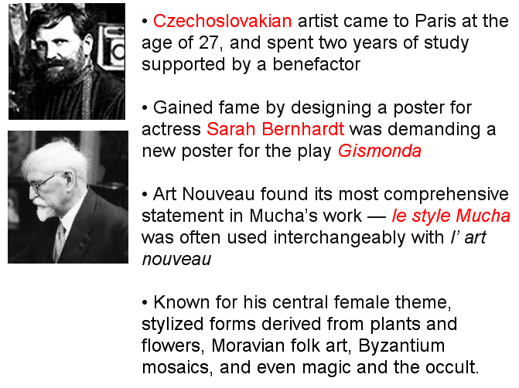
Alphonse Mucha 1860-1938

Slide 21
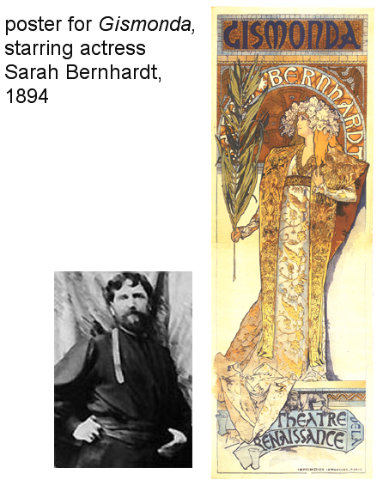
Alphonse Mucha

Slide 22
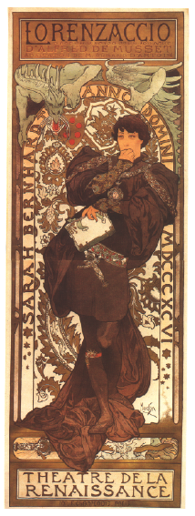
Alphonse Mucha
Poster for
Lorenzaccio, starring Sarah Bernhardt

Slide 23
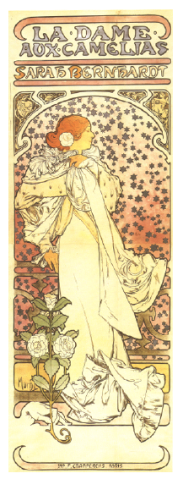
Alphonse Mucha
Poster for
La Dame Aux Camelias
starring Sarah Bernhardt

Slide 24
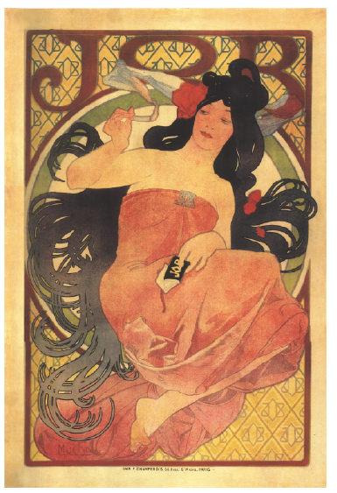
Alphonse Mucha
Poster advertising JOB cigarette rolling papers. JOB Papers used this poster again in the late 1960s.

Slide 25
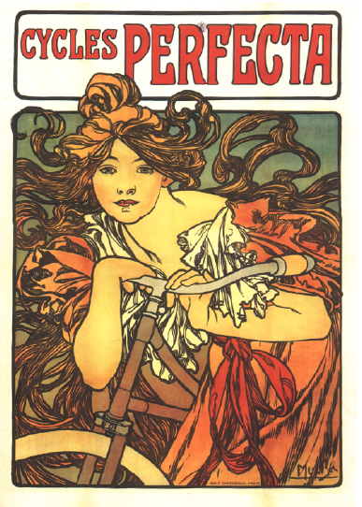
Alphonse Mucha
Poster advertising Cycles Perfecta

Slide 26
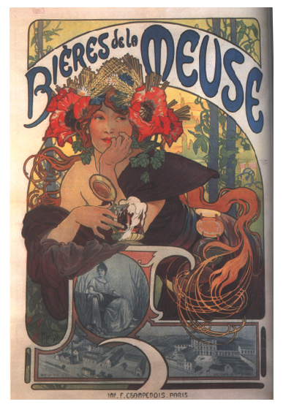
Alphonse Mucha
Poster advertising Beer

Slide 27
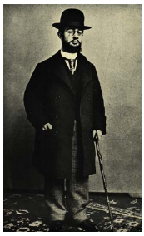
Henri de Toulouse-Lautrec 1864-1901

Slide 28
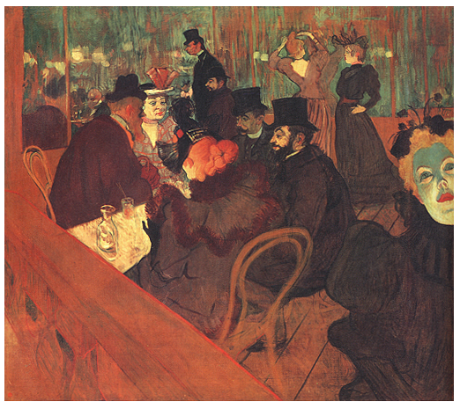
Henri de Toulouse-Lautrec
“Fine Art”
At the Moulin Rouge
oil painting

Slide 29
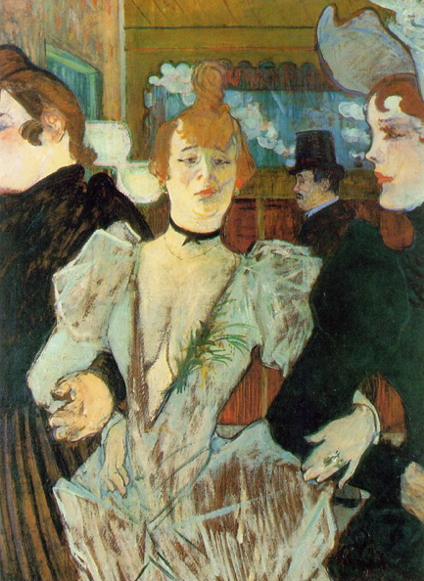
Henri de Toulouse-Lautrec
La Goulue and Two Women
oil painting

Slide 30
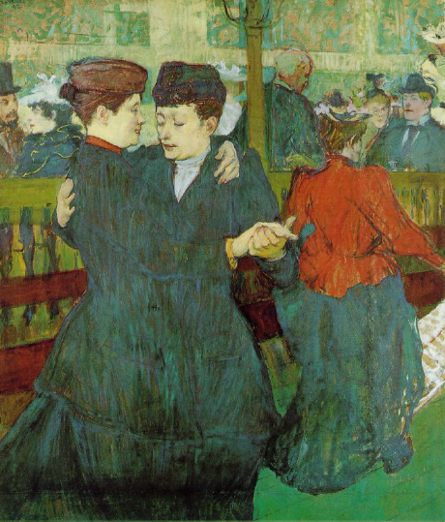
Henri de Toulouse-Lautrec
Two Women Waltzing
oil painting

Slide 31
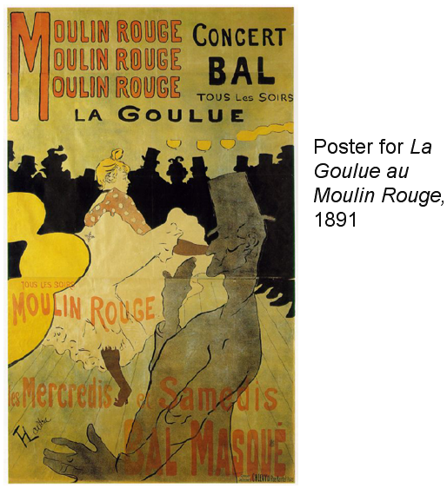
Henri de Toulouse-Lautrec

Slide 32
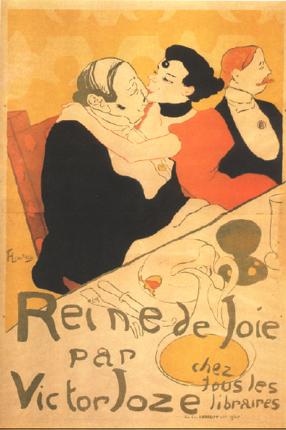
Henri de Toulouse-Lautrec
Reine de Joie
Poster 1892

Slide 33
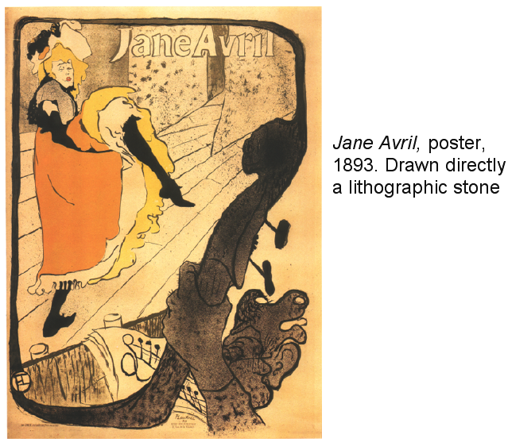
Henri de Toulouse-Lautrec

Slide 34
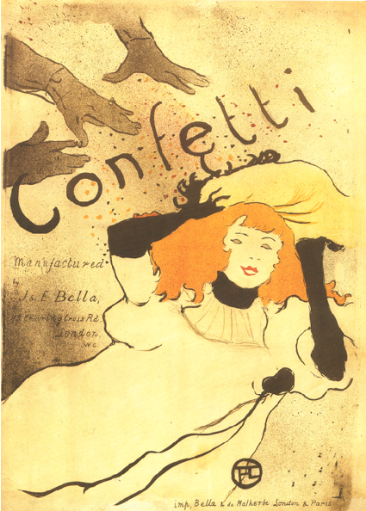
Henri de Toulouse-Lautrec
Confetti
Poster 1893

Slide 35
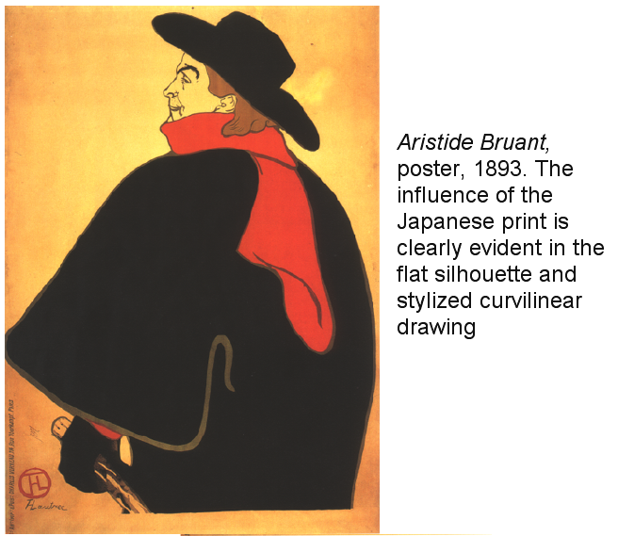
Henri de Toulouse-Lautrec

Slide 36
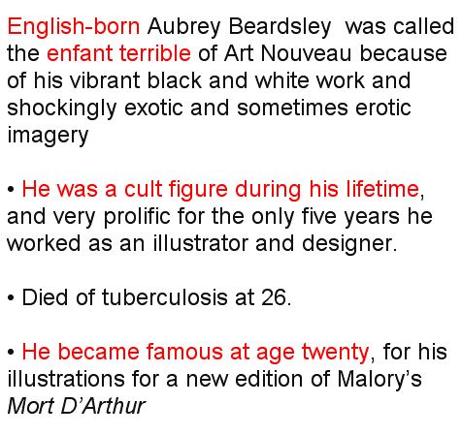
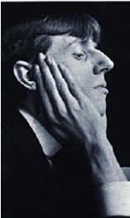
Aubrey Beardsley 1872-1898

Slide 37
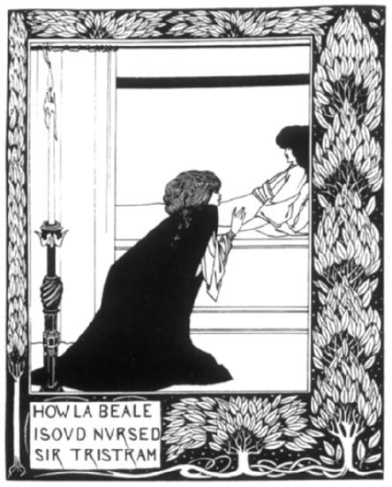
Aubrey Beardsley
Mort de Arthur
(Death of King Arthur)
Book illustration 1893

Slide 38
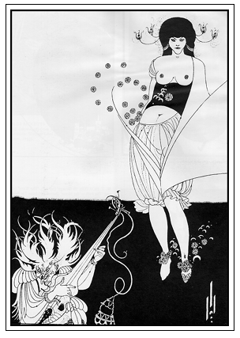
Aubrey Beardsley
Salome
Book illustration 1894

Slide 39
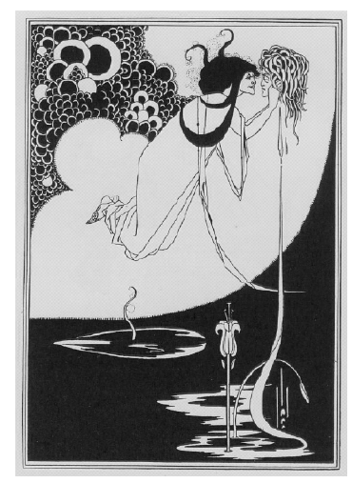
Aubrey Beardsley
Salome
Book illustration 1894

Slide 40
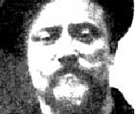
Privat Livemont 1861-1936

Slide 41
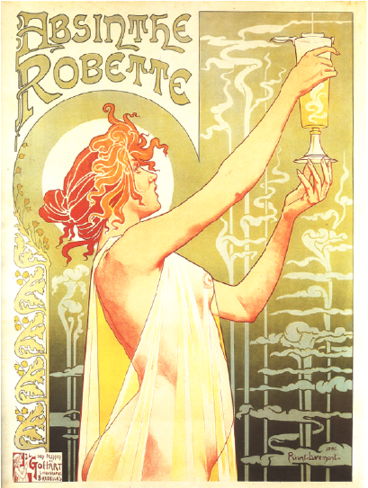
Privat Livemont
1896 Poster for Robette Absinthe

Slide 42
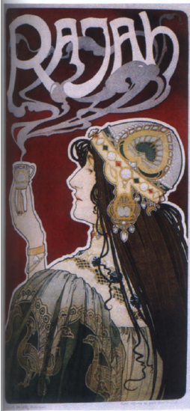
Privat Livemont
1899 Poster for Rajah Coffee

Slide 43
Paul Emile Berthon 1872-1909
Berthon was a French artist who produced primarily posters and lithographs. Berthon's work is in the style of Art Nouveau, much like his contemporary Alphonse Mucha. Berthon studied as a painter in Villefranche before moving to Paris. He later enrolled at the Ecole Normale d'Enseignement de Dessin and received lessons from Luc-Olivier Merson.
His study of the decorative arts influenced his print making, influencing the strong lines and natural details that guided his art. The vast majority of Berthon's lithographed posters did not include advertisements and were meant to stand on their own.

Slide 44
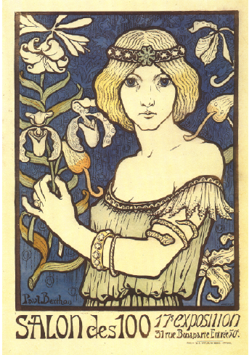
Paul Berthon
1895 art exposition

Slide 45
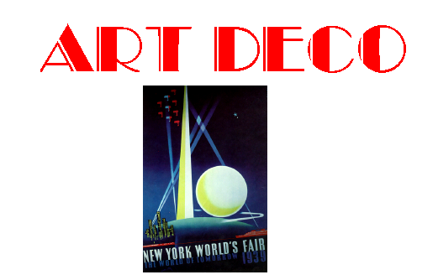
ARTC 2316 History of Communication Graphics

Slide 49
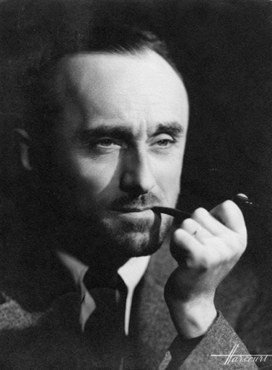
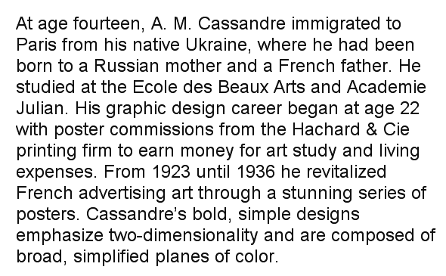
A. M. Cassandre

Slide 50
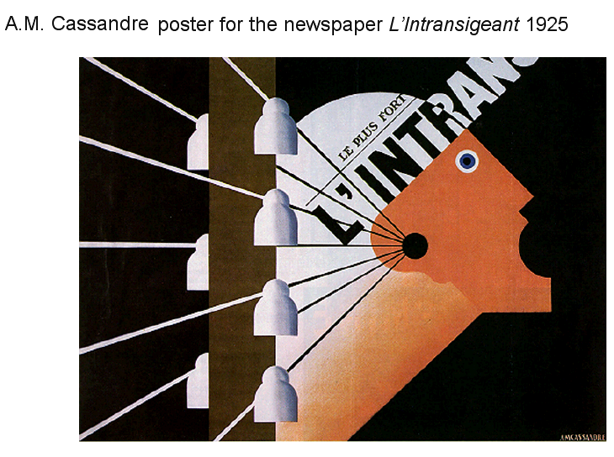

Slide 54
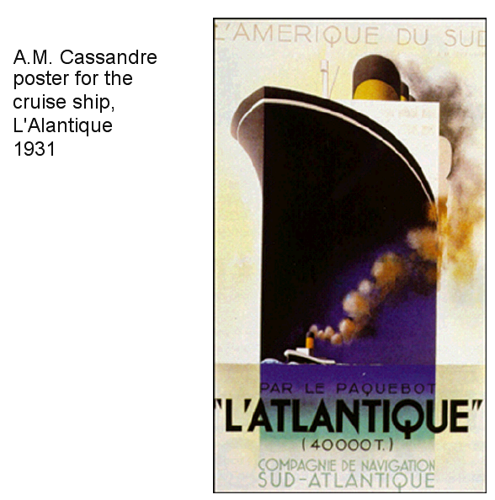

Slide 55
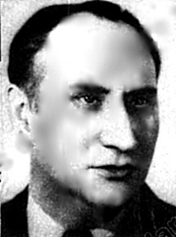

Slide 58
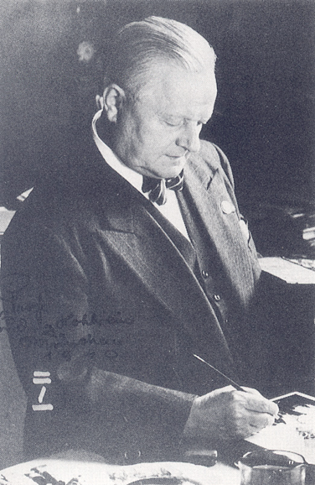
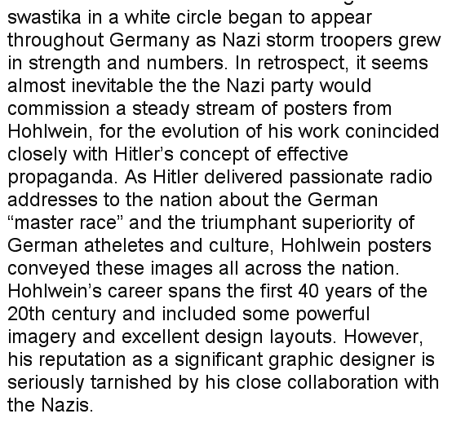
Ludwig Hohlwein

Slide 59
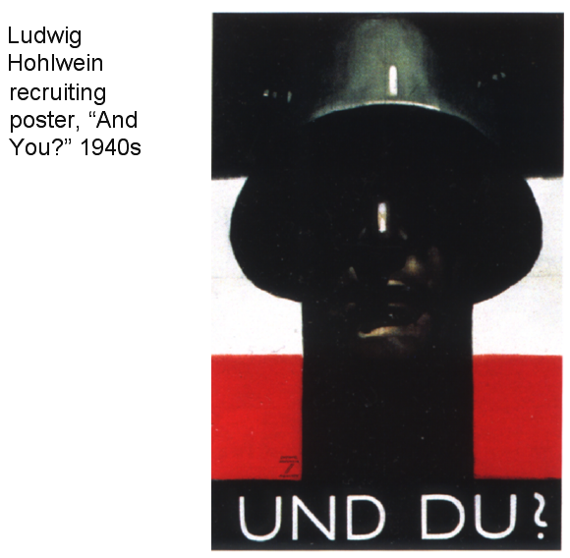

Slide 62
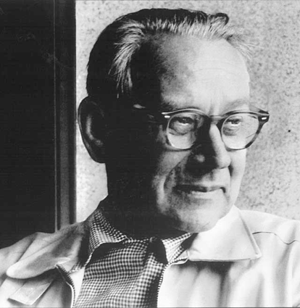

Slide 63
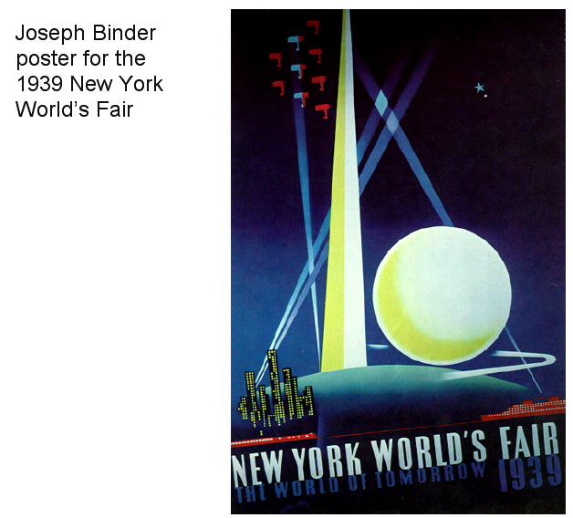

Slide 65
Schulz-Neudamm
Heinz Schulz-Neudamm was actually Paul Heinz Otto Schulz. He was a German graphic designer and illustrator who worked until the 1940s in Berlin. He called himself after his birthplace Schulz-Neudamm. He created numerous advertising themes for various film companies working mostly for German studios. He also worked with American Distributors including the Fox Company (later called 20th Century Fox). He is best known for his 1926 poster for the ground-breaking German film Metropolis directed by Fritz Lang.

Slide 66
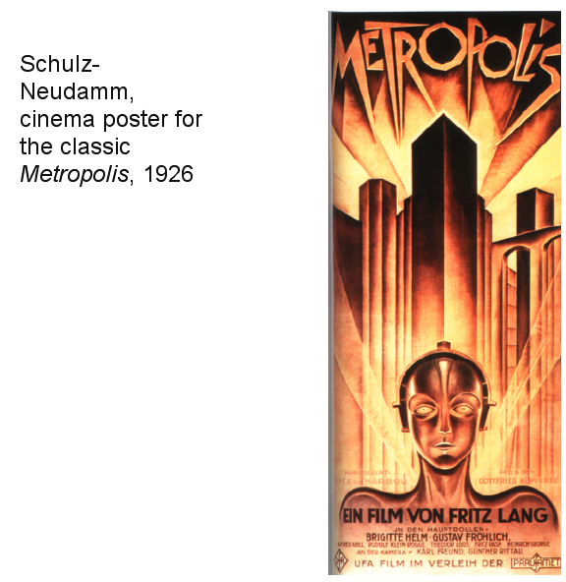

Slide 67
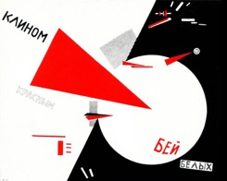
ARTC 2316 History of Communication Graphics

Slide 68
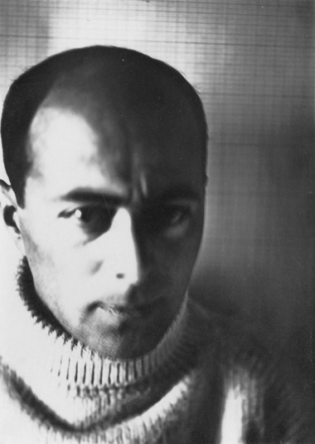
El Lissitzky
Lissitzky was born on November 23, 1890 in Pochinok, a small Jewish community 50 kilometres (31 mi) southeast of Smolensk, former Russian Empire. During his childhood, he lived and studied in the city of Vitebsk, now part of Belarus, and later spent 10 years in Smolensk living with his grandparents and attending the Smolensk Grammar School, spending summer vacations in Vitebsk.^{[3]} Always expressing an interest and talent in drawing, he started to receive instruction at 13 from Yehuda Pen, a local Jewish artist, and by the time he was 15 was teaching students himself. In 1909, he applied to an art academy in Saint Petersburg, but was rejected. While he passed the entrance exam and was qualified, the law under the Tsarist regime only allowed a limited number of Jewish students to attend Russian schools and universities.
Like many other Jews then living in the Russian Empire, Lissitzky went to study in Germany. He left in 1909 to study architectural engineering at a Technische Hochschule in Darmstadt, Germany.^{[1]} During the summer of 1912, Lissitzky, in his own words, "wandered through Europe", spending time in Paris and covering 1,200 kilometres (750 mi) on foot in Italy, teaching himself about fine art and sketching architecture and landscapes that interested him.^{[4]} His interest in ancient Jewish culture had originated during the contacts with a Paris-based group of Russian Jews led by sculptor Ossip Zadkine, a lifetime friend of Lissitzky since early childhood, who exposed Lissitzky to conflicts between different groups within the diaspora.^{[5]} Also in 1912 some of his pieces were included for the first time in an exhibit by the St. Petersburg Artists Union; a notable first step. He remained in Germany until the outbreak of World War I, when he was forced to return home through Switzerland and the Balkans,^{[6]} along with many of his countrymen, including other expatriate artists born in the former Russian Empire, such as Wassily Kandinsky and Marc Chagall.^{[1]}
Upon his return to Moscow, Lissitzky attended the Polytechnic Institute of Riga, which had been evacuated to Moscow because of the war,^{[7]} and worked for the architectural firms of Boris Velikovsky and Roman Klein.^{[6]} During this work, he took an active and passionate interest in Jewish culture which, after the downfall of the openly antisemitic Tsarist regime, was experiencing a renaissance. The new Provisional Government repealed a decree that prohibited the printing of Hebrew letters and that barred Jews from citizenship. Thus Lissitzky soon devoted himself to Jewish art, exhibiting works by local Jewish artists, traveling to Mahilyow to study the traditional architecture and ornaments of old synagogues, and illustrating many Yiddish children's books. These books were Lissitzky's first major foray in book design, a field that he would greatly innovate during his career.
Lissitzky's The Constructor, 1924, London, Victoria & Albert Museum
His first designs appeared in the 1917 book, Sihas hulin: Eyne fun di geshikhten (An Everyday Conversation), where he incorporated Hebrew letters with a distinctly art nouveau flair. His next book was a visual retelling of the traditional Jewish Passover song Had gadya (One Goat), in which Lissitzky showcased a typographic device that he would often return to in later designs. In the book, he integrated letters with images through a system that matched the color of the characters in the story with the word referring to them. In the designs for the final page, Lissitzky depicts the mighty "hand of God" slaying the angel of death, who wears the tsar's crown. This representation links the redemption of the Jews with the victory of the Bolsheviks in the Russian Revolution.^{[8]} An alternative view asserts that the artist was wary of Bolshevik internationalization, leading to destruction of traditional Jewish culture.^{[9]} Visual representations of the hand of God would recur in numerous pieces throughout his entire career, most notably with his 1924^{[10]} photomontage self-portrait The Constructor, which prominently featured the hand.
Avant Garde
Suprematism
Proun. 1st Kestner Portfolio
In May 1919,^{[3]} upon receiving an invitation from fellow Jewish artist Marc Chagall, Lissitzky returned to Vitebsk to teach graphic arts, printing, and architecture at the newly formed People's Art School – a school that Chagall created after being appointed Commissioner of Artistic Affairs for Vitebsk in 1918. Lissitzky was engaged in designing and printing propaganda posters; later, he preferred to keep quiet about this period, probably because one of main subjects of these posters was the exile Leon Trotsky.^{[11]} The quantity of these posters is sufficient to regard them as a separate genre in the artist's output.^{[12]}
Chagall also invited other Russian artists, most notably the painter and art theoretician Kazimir Malevich and Lissitzky's former teacher, Yehuda Pen. However, it was not until October 1919 when Lissitzky, then on an errand in Moscow, persuaded Malevich to relocate to Vitebsk.^{[13]} The move coincided with the opening of the first art exhibition in Vitebsk directed by Chagall.^{[14]} Malevich would bring with him a wealth of new ideas, most of which inspired Lissitzky but clashed with local public and professionals who favored figurative art and with Chagall himself.^{[15]} After going through impressionism, primitivism, and cubism, Malevich began developing and advocating his ideas on suprematism aggressively. In development since 1915, suprematism rejected the imitation of natural shapes and focused more on the creation of distinct, geometric forms. He replaced the classic teaching program with his own and disseminated his suprematist theories and techniques school-wide. Chagall advocated more classical ideals and Lissitzky, still loyal to Chagall, became torn between two opposing artistic paths. Lissitzky ultimately favoured Malevich's suprematism and broke away from traditional Jewish art. Chagall left the school shortly thereafter.
Beat the Whites with the Red Wedge, 1919
At this point Lissitzky subscribed fully to suprematism and, under the guidance of Malevich, helped further develop the movement. In 1919–1920 Lissitzky was a head of Architectural department at the People's Art School where with his students, primarily Lazar Khidekel, he was working on transition from plane to volumetric suprematism.^{[16]} Lissitzky designed On the New System of Art by Malevich, who responded in December 1919: "Lazar Markovich, I salute you on the publication of this little book".^{[17]} Perhaps the most famous work by Lissitzky from the same period was the 1919 propaganda poster "Beat the Whites with the Red Wedge". Russia was going through a civil war at the time, which was mainly fought between the "Reds" (communists, socialists and revolutionaries) and the "Whites" (monarchists, conservatives, liberals and other socialists who opposed the Bolshevik Revolution). The image of the red wedge shattering the white form, simple as it was, communicated a powerful message that left no doubt in the viewer's mind of its intention. The piece is often seen as alluding to the similar shapes used on military maps and, along with its political symbolism, was one of Lissitzky's first major steps away from Malevich's non-objective suprematism into a style his own. He stated: "The artist constructs a new symbol with his brush. This symbol is not a recognizable form of anything that is already finished, already made, or already existent in the world – it is a symbol of a new world, which is being built upon and which exists by the way of the people."^{[18]}
In January 17, 1920,^{[19]} Malevich and Lissitzky co-founded the short-lived Molposnovis (Young followers of a new art), a proto-suprematist association of students, professors, and other artists. After a brief and stormy dispute between "old" and "young" generations, and two rounds of renaming, the group reemerged as UNOVIS (Exponents of the new art) in February.^{[20][21]} Under the leadership of Malevich the group worked on a "suprematist ballet", choreographed by Nina Kogan and on the remake of a 1913 futurist opera Victory Over the Sun by Mikhail Matyushin and Aleksei Kruchenykh.^{[20][22]} Lissitzky and the entire group chose to share credit and responsibility for the works produced within the group, signing most pieces with a black square. This was partly a homage to a similar piece by their leader, Malevich, and a symbolic embrace of the Communist ideal. This would become the de facto seal of UNOVIS that took the place of individual names or initials. Black squares worn by members as chest badges and cufflinks also resembled the ritual tefillin and thus were no strange symbol in Vitebsk shtetl.^{[23]}
The group, which disbanded in 1922, would be pivotal in the dissemination of suprematist ideology in Russia and abroad and launch Lissitzky's status as one of the leading figures in the avant garde. Incidentally, the earliest appearance of the signature Lissitzky (Russian: Эль Лисицкий) emerged in the handmade UNOVIS Miscellany, issued in two copies in March–April 1920,^{[24]} and containing his manifesto on book art: "the book enters the skull through the eye not the ear therefore the pathways the waves move at much greater speed and with more intensity. if i (sic) can only sing through my mouth with a book i (sic) can show myself in various guises."^{[25]}
Proun
A Proun, c.1925. Commenting on Proun in 1921, Lissitzky stated, "We brought the canvas into circles . . . and while we turn, we raise ourselves into the space."^{[8]}
During this period Lissitzky proceeded to develop a suprematist style of his own, a series of abstract, geometric paintings which he called Proun (pronounced "pro-oon"). The exact meaning of "Proun" was never fully revealed, with some suggesting that it is a contraction of proekt unovisa (designed by UNOVIS) or proekt utverzhdenya novogo (Design for the confirmation of the new). Later, Lissitzky defined them ambiguously as "the station where one changes from painting to architecture."^{[4]}
Proun was essentially Lissitzky's exploration of the visual language of suprematism with spatial elements, utilizing shifting axes and multiple perspectives; both uncommon ideas in suprematism. Suprematism at the time was conducted almost exclusively in flat, 2D forms and shapes, and Lissitzky, with a taste for architecture and other 3D concepts, tried to expand suprematism beyond this. His Proun works (known as Prounen) spanned over a half a decade and evolved from straightforward paintings and lithographs into fully three-dimensional installations. They would also lay the foundation for his later experiments in architecture and exhibition design. While the paintings were artistic in their own right, their use as a staging ground for his early architectonic ideas was significant. In these works, the basic elements of architecture – volume, mass, color, space and rhythm – were subjected to a fresh formulation in relation to the new suprematist ideals. Through his Prouns, utopian models for a new and better world were developed. This approach, in which the artist creates art with socially defined purpose, could aptly be summarized with his edict "das zielbewußte Schaffen" – "task oriented creation."^{[2]}
Jewish themes and symbols also sometimes made appearances in his Prounen, usually with Lissitzky using Hebrew letters as part of the typography or visual code. For the cover of the 1922 book Arba'ah Teyashim (Four Billy Goats; cover), he shows an arrangement of Hebrew letters as architectural elements in a dynamic design that mirrors his contemporary Proun typography.^{[8]} This theme was extended into his illustrations for the Shifs-Karta (Passenger Ticket) book.
Return to Germany
International Congress of Progressive Artists, May 1922, Lissitzky 9th from left
In 1921, roughly concurrent with the demise of UNOVIS, suprematism was beginning to fracture into two ideologically adverse halves, one favoring Utopian, spiritual art and the other a more utilitarian art that served society. Lissitzky was fully aligned with neither and left Vitebsk in 1921. He took a job as a cultural representative of Russia and moved to Berlin where he was to establish contacts between Russian and German artists. There he also took up work as a writer and designer for international magazines and journals while helping to promote the avant-garde through various gallery shows. He started the very short-lived but impressive periodical Veshch-Gegenstand Objekt with Russian-Jewish writer Ilya Ehrenburg. This was intended to display contemporary Russian art to Western Europe. It was a wide-ranging pan-arts publication, mainly focusing on new suprematist and constructivist works, and was published in German, French and Russian.^{[26]} In the first issue, Lissitzky wrote:
We consider the triumph of the constructive method to be essential for our present. We find it not only in the new economy and in the development of the industry, but also in the psychology of our contemporaries of art. Veshch will champion constructive art, whose mission is not, after all, to embellish life, but to organize it.^{[2]}
During his stay Lissitzky also developed his career as a graphic designer with some historically important works such as the books Dlia Golossa (For the Voice), a collection of poems from Vladimir Mayakovsky, and Die Kunstismen (The Artisms) together with Jean Arp. In Berlin he also met and befriended many other artists, most notably Kurt Schwitters, László Moholy-Nagy, and Theo van Doesburg.^{[27]} Together with Schwitters and van Doesburg, Lissitzky presented the idea of an international artistic movement under the guidelines of constructivism while also working with Kurt Schwitters on the issue Nasci (Nature) of the periodical Merz, and continuing to illustrate children's books. The year after the publication of his first Proun series in Moscow in 1921, Schwitters introduced Lissitzky to the Hanover gallery kestnergesellschaft, where he held his first solo exhibition. The second Proun series, printed in Hanover in 1923, was a success, utilizing new printing techniques.^{[26]} Later on, he met Sophie Kuppers, who was the widow of Paul Kuppers, an art director of the kestnergesellschaft at which Lissitzky was showing, and whom he would marry in 1927.
Horizontal skyscrapers
In 1923–1925, Lissitzky proposed and developed the idea of horizontal skyscrapers (Wolkenbügel, "cloud-irons"). A series of eight such structures was intended to mark the major intersections of the Boulevard Ring in Moscow. Each Wolkenbügel was a flat three-story, 180-meter-wide L-shaped slab raised 50 meters above street level. It rested on three pylons (10×16×50 meters each), placed on three different street corners. One pylon extended underground, doubling as the staircase into a proposed subway station; two others provided shelter for ground-level tram stations.^{[28][29]}
Lissitzky argued that as long as humans cannot fly, moving horizontally is natural and moving vertically is not. Thus, where there is not sufficient land for construction, a new plane created in the air at medium altitude should be preferred to an American-style tower. These buildings, according to Lissitzky, also provided superior insulation and ventilation for their inhabitants.^{[30]}
The print shop designed by El Lissitzky, showing the least damaged south end of the building
Lissitzky, aware of severe mismatch between his ideas and the existing urban landscape, experimented with different configurations of the horizontal surface and height-to-width ratios so that the structure appeared balanced visually ("spatial balance is in the contrast of vertical and horizontal tensions").^{[30]} The raised platform was shaped in a way that each of its four facets looked distinctly different. Each tower faced the Kremlin with the same facet, providing a pointing arrow to pedestrians on the streets. All eight buildings were planned identically, so Lissitzky proposed color-coding them for easier orientation.^{[31]}
An illustration of the concept appeared on the front cover of Adolf Behne's book Der Moderne Zweckbau, and articles on it written by Lissitzky appeared in the Moscow-based architectural review ASNOVA News (journal of ASNOVA, the Association of New Architects) and in the German art journal Das Kunstblatt.
After some time of creating "paper architecture" projects such as the Wolkenbügels he was hired to design an actual building in Moscow. Located at 55.777277°N 37.610828°E 17, 1st Samotechny Lane, it is Lissitzky's sole tangible work of architecture. It was commissioned in 1932 by Ogonyok magazine to be used as a print shop. In June 2007 the independent Russky Avangard foundation filed a request to list the building on the heritage register. In September 2007 the city commission (Moskomnasledie) approved the request and passed it to the city government for a final approval, which did not happen. In October 2008, the abandoned building was badly damaged by fire.^{[32]}
Exhibitions of the 1920s
After two years of intensive work Lissitzky was taken ill with acute pneumonia in October 1923. A few weeks later he was diagnosed with pulmonary tuberculosis; in February 1924 he relocated to a Swiss sanatorium near Locarno.^{[33]} He kept very busy during his stay, working on advertisement designs for Pelikan Industries (who in turn paid for his treatment), translating articles written by Malevich into German, and experimenting heavily in typographic design and photography. In 1925, after the Swiss government denied his request to renew his visa, Lissitzky returned to Moscow and began teaching interior design, metalwork, and architecture at VKhUTEMAS (State Higher Artistic and Technical Workshops), a post he would keep until 1930. He all but stopped his Proun works and became increasingly active in architecture and propaganda designs.
In June 1926, Lissitzky left the country again, this time for a brief stay in Germany and the Netherlands. There he designed an exhibition room for the Internationale Kunstausstellung art show in Dresden and the Raum Konstruktive Kunst (Room for constructivist art) and Abstraktes Kabinett shows in Hanover, and perfected the 1925 Wolkenbügel concept in collaboration with Mart Stam.^{[33]} In his autobiography (written in June 1941, and later edited and released by his wife), Lissitzky wrote, "1926. My most important work as an artist begins: the creation of exhibitions."^{[4]}
Back in the USSR, Lissitzky designed displays for the official Soviet pavilions at the international exhibitions of the period, up to the 1939 New York World's Fair. One of his most notable exhibits was the All-Union Polygraphic Exhibit in Moscow in August–October 1927, where Lissitzky headed the design team for "photography and photomechanics" (i.e. photomontage) artists and the installation crew.^{[34]} His work was perceived as radically new, especially when juxtaposed with the classicist designs of Vladimir Favorsky (head of the book art section of the same exhibition) and of the foreign exhibits.
In the beginning of 1928, Lissitzky visited Cologne in preparation for the 1928 Pressa Show scheduled for April–May 1928. The state delegated Lissitzky to supervise the Soviet program; instead of building their own pavilion, the Soviets rented the existing central pavilion, the largest building on the fairground. To make full use of it, the Soviet program designed by Lissitsky revolved around the theme of a film show, with nearly continuous presentation of the new feature films, propagandist newsreels and early animation, on multiple screens inside the pavilion and on the open-air screens.^{[35]} His work was praised for near absence of paper exhibits; "everything moves, rotates, everything is energized" (Russian: всё движется, заводится, электрифицируется).^{[36]} Lissitzky also designed and managed on site less demanding exhibitions like the 1930 Hygiene show in Dresden.^{[37]}
Along with pavilion design, Lissitzky began experimenting with print media again. His work with book and periodical design was perhaps some of his most accomplished and influential. He launched radical innovations in typography and photomontage, two fields in which he was particularly adept. He even designed a photomontage birth announcement in 1930 for his recently born son, Jen. The image itself is seen as being another personal endorsement of the Soviet Union,^{[8]} as it superimposed an image of the infant Jen over a factory chimney, linking Jen's future with his country's industrial progress. Around this time, Lissitzky's interest in book design escalated. In his remaining years, some of his most challenging and innovative works in this field would develop. In discussing his vision of the book, he wrote:
In contrast to the old monumental art [the book] itself goes to the people, and does not stand like a cathedral in one place waiting for someone to approach . . . [The book is the] monument of the future.^{[2]}
He perceived books as permanent objects that were invested with power. This power was unique in that it could transmit ideas to people of different times, cultures, and interests, and do so in ways other art forms could not. This ambition laced all of his work, particularly in his later years. Lissitzky was devoted to the idea of creating art with power and purpose, art that could invoke change.
Later years
In 1932, Stalin closed down independent artists' unions; former avant-garde artists had to adapt to the new climate or risk being officially criticised or even blacklisted. Lissitzky retained his reputation as the master of exhibition art and management into the late 1930s. His tuberculosis gradually reduced his physical abilities, and he was becoming more and more dependent on his wife in actual completion of his work.^{[38]}
In 1937, Lissitzky served as the lead decorator for the upcoming All-Union Agricultural Exhibition, reporting to the master planner Vyacheslav Oltarzhevsky but largely independent and highly critical of him. The project was plagued by delays and political interventions. By the end of 1937 the "apparent simplicity" of Lissitzky's artwork aroused the concerns of the political supervisors, and Lissitzky responded: "The simpler the shape, the finer precision and quality of execution required... yet until now [the working crews] are instructed by the foremen (Oltarzhevsky and Korostashevsky), not the authors" (i.e. Vladimir Shchuko, author of the Central Pavilion, and Lissitzky himself).^{[39]} His artwork, as described in 1937 proposals, completely departed from the modernist art of the 1920s in favor of socialist realism. The iconic statue of Stalin in front of the central pavilion was proposed by Lissitzky personally: "this will give the square its head and its face" (Russian: Это должно дать площади и голову и лицо).^{[39]}
In June 1938, he was only one of seventeen professionals and managers responsible for the Central Pavilion;^{[40]} in October 1938, he shared the responsibility for its Main Hall decoration with Vladimir Akhmetyev.^{[41]} He simultaneously worked on the decoration of the Soviet pavilion for the 1939 New York World's Fair; the June 1938 commission considered Lissitzky's work along with nineteen other proposals and eventually rejected it.^{[42]}
Lissitzky's work on the USSR im Bau (USSR in construction) magazine took his experimentation and innovation with book design to an extreme. In issue #2 he included multiple fold-out pages, presented in concert with other folded pages that together produced design combinations and a narrative structure that was completely original. Each issue focused on a particular issue of the time – a new dam being built, constitutional reforms, Red Army progress and so on. In 1941, his tuberculosis worsened, but he continued to produce works, one of his last being a propaganda poster for Russia's efforts in World War II, titled "Davaite pobolshe tankov!" (Give us more tanks!) He died on December 30, 1941, in Moscow.

Slide 69
El Lissitzky: Beat the Whites with the Red Wedge

Slide 70
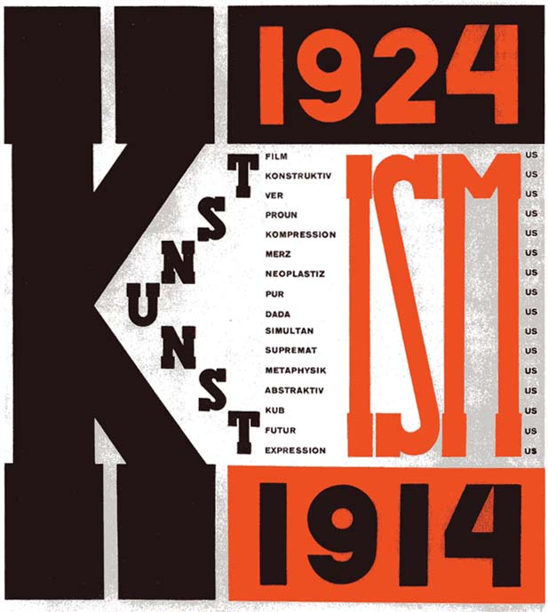
El Lissitzky:

Slide 71
Dadaism

Slide 72
Alexander Rodchenko
Rodchenko was born in St. Petersburg to a working-class family who moved to Kazan after the death of his father, in 1909.^{[1]} He become an artist without having had any exposure to the art world, drawing much inspiration from art magazines.

Slide 73
Alexander Rodchenko
Russian Constructivism

Slide 74
Alexander Rodchenko
Russian Constructivism

Slide 75
Alexander Rodchenko
Russian Constructivism

Slide 76
Piet Mondrian
Pieter Cornelis "Piet" Mondriaan March 7, 1872 – February 1, 1944), was a Dutch painter.
He was a contributor to the De Stijl art movement and group, which was founded by Theo van Doesburg int the Netherlands. He evolved a non-representational form which he termed neoplasticism.

Slide 77
Piet Mondrian
Composition in Red, Blue and Yellow (1930)

Slide 78
Laszlo Moholy-Nagy
Moholy-Nagy was born László Weisz in Bácsborsód to a Jewish-Hungarian family.^{[2]} His cousin was the conductor Sir Georg Solti. He attended Gymnasium (academic high school) in the city of Szeged. He changed his German-Jewish surname to the Magyar surname of his mother's Christian lawyer friend Nagy, who supported the family and helped raise Moholy-Nagy and his brothers when their Jewish father, Lipót Weisz left the family. Later, he added “Moholy” ("from Mohol") to his surname.

Slide 79
Laslo Moholy-Nagy
Russian Stenburg Bros.

Slide 80
Laslo Moholy-Nagy
Russian Stenburg Bros.

Slide 81
Laslo Moholy-Nagy
Russian Stenburg Bros.

Slide 82
Laslo Moholy-Nagy
Russian Stenburg Bros.

Slide 83
Laslo Moholy-Nagy
Russian Stenburg Bros.

Slide 84
John Heartfield
John Heartfield (born Helmut Herzfeld; 19 June 1891 – 26 April 1968) was an artist. He was a pioneer in the use of art as a political weapon. Some of his photomontages were anti-Nazi and anti-fascist statements. Heartfield also created book jackets for authors such as Upton Sinclair, as well as stage sets for such noted playwrights as Bertolt Brecht and Erwin Piscator.
John Heartfield (Helmut Herzfeld) was born on 19 June 1891 in Berlin-Schmargendorf. His father was Franz Herzfeld, a socialist writer, and his mother was Alice (née Stolzenburg), a textile worker and political activist..^{[6]}

Slide 85
The Hitler Salute (AIZ), by John Heartfield

Slide 86
This is the Salvation They Bring, by John Heartfield

Slide 87
The new Nazi Church, by John Heartfield

Slide 88
Adolf the Superman, Swallows Gold and Spouts Tin, by John Heartfield

Slide 89
Walter Gropius
Gropius's career advanced in the postwar period. Henry van de Velde, the master of the Grand-Ducal Saxon School of Arts and Crafts in Weimar was asked to step down in 1915 due to his Belgian nationality. His recommendation for Gropius to succeed him led eventually to Gropius's appointment as master of the school in 1919.

Slide 90
Walter Gropius

Slide 91
Walter Gropius Director’s home for the Bauhaus in Dessau

Slide 92
Herbert Bayer
Herbert Bayer (April 5, 1900 – September 30, 1985) was born in Haag, Austria. He was was a graphic designer, painter, photographer, sculptor, art director, environmental and interior designer, and architect, who was very well recognized as the last living member of the Bauhaus and was instrumental in the development of the Atlantic Richfield Company’s corporate art collection until his death in 1985.
Bayer entered Bauhaus as a student but stayed and joined that team as one notable faculty members

Slide 93
Herbert Bayer Poster for Kandinsky's 60th birthday exhibition in Dessau

Slide 94
Herbert Bayer

Slide 95
Joost Schmidt
Joost Schmidt (Wunstorf, 5 January 1893 - Nürnberg, 2 December 1948) was a teacher or master at the Bauhaus and later a professor at the College of Visual Arts, Berlin. He was a visionary typographer and graphic designer who is best known for designing the famous poster for the 1923 Bauhaus Exhibition in Weimar, Germany.

Slide 96
Joost Schmidt

Slide 97
Joost Schmidt Dessau, 1930

Slide 98
Joost Schmidt

Slide 99
Marcel Breuer
Marcel Lajos Breuer (pronounced BROY-ər; 22 May 1902 – 1 July 1981), was a Hungarian-born modernist, architect and furniture designer. One of the masters of Modernism, Breuer extended the sculptural vocabulary he had developed in the carpentry shop at the Bauhaus into a personal architecture that made him one of the world's most popular architects at the peak of 20th-Century design.

Slide 100
Wassily Chair, by Marcel Bruer

Slide 101
Marcel Breuer

Slide 102
Late Modern

